Slide 1

zkLogin: Onboarding the next billion users to web3
Deepak Maram
Jointly with Kostas Chalkias | Yan Ji | Jonas Lindstrøm | Ben Riva | Arnab Roy | Mahdi Sedaghat | Joy Wang
SBC 2024

Slide 2
There are fewer than
100 million
active crypto wallets

Slide 3
and there are
BILLIONS
of web2 accounts

Slide 4
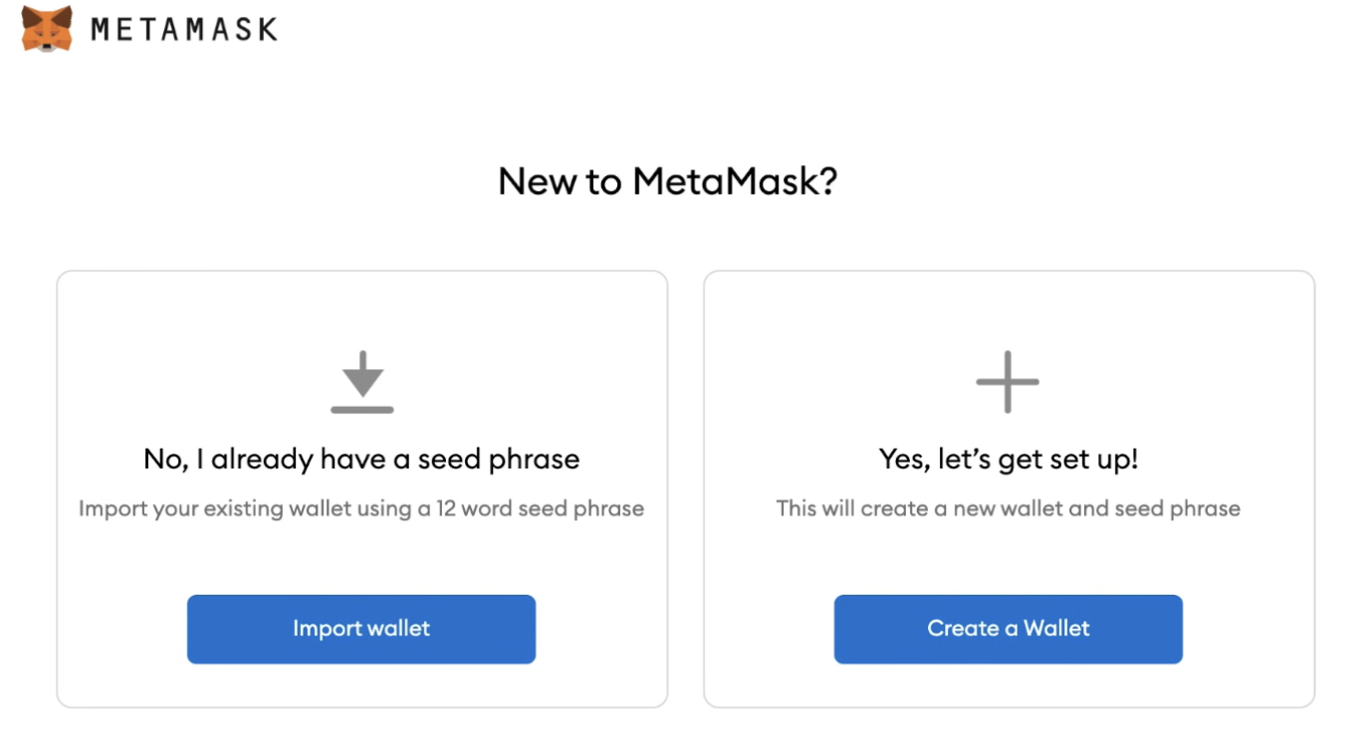
Web3 has an onboarding problem

Slide 5
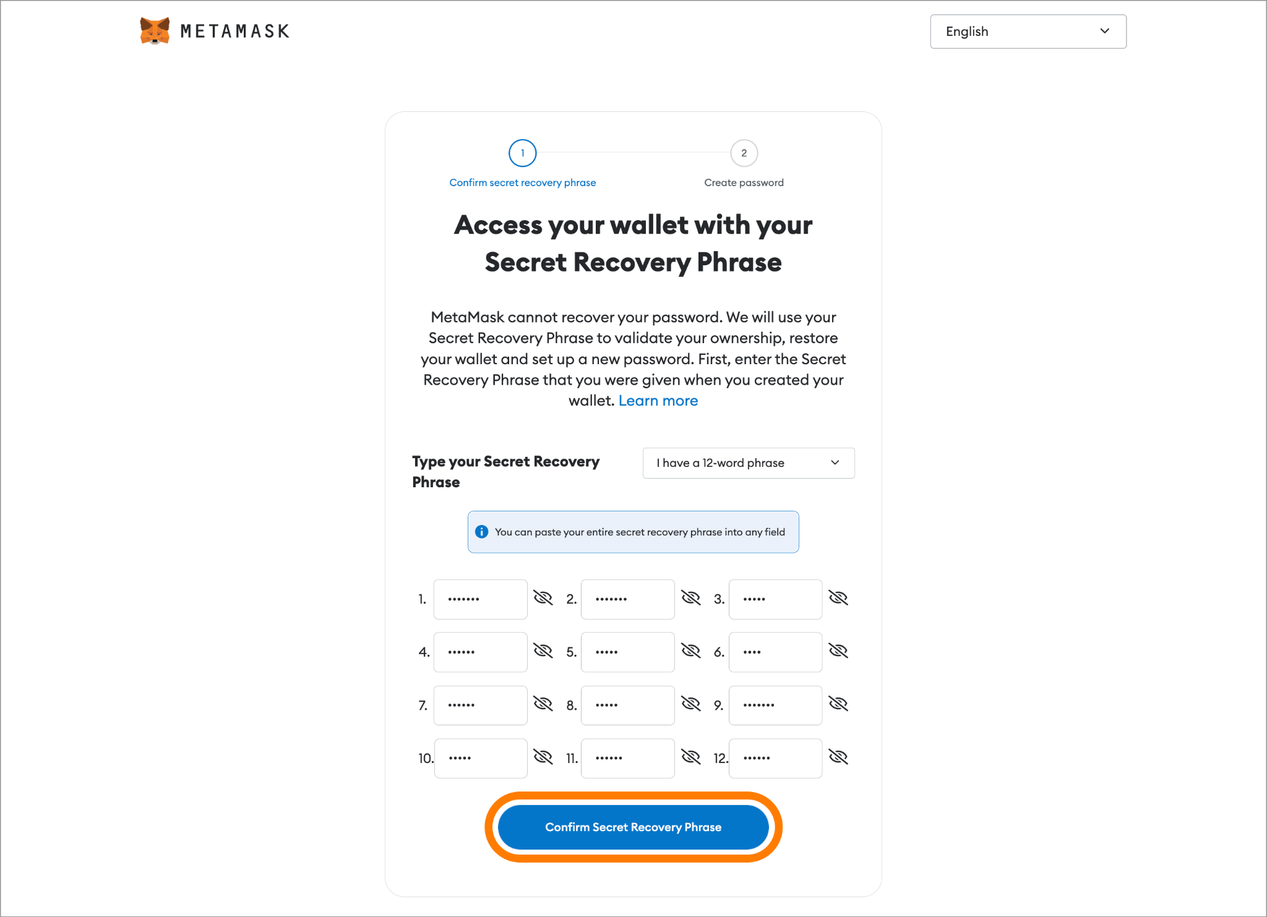
Web3 has an onboarding problem

Slide 6
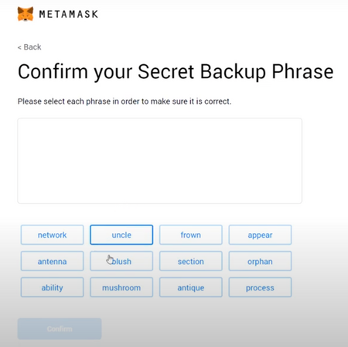
Web3 has an onboarding problem

Slide 7
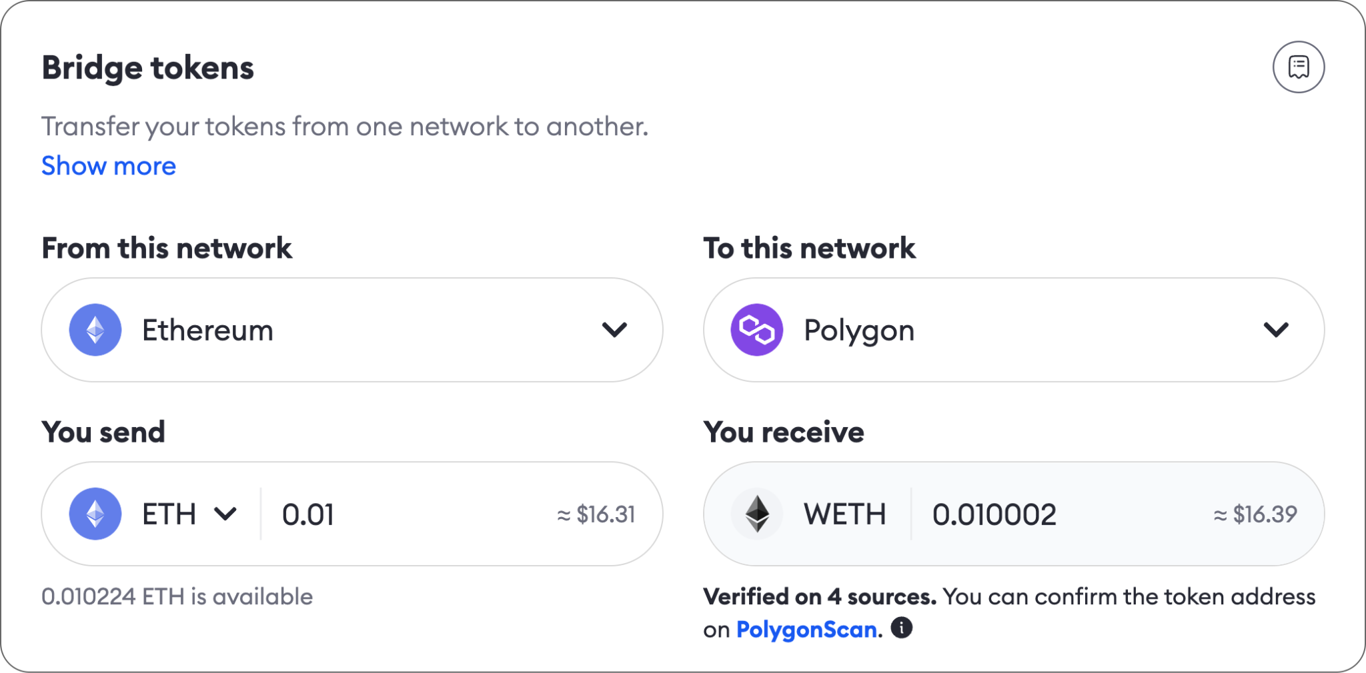
Web3 has an onboarding problem

Slide 8
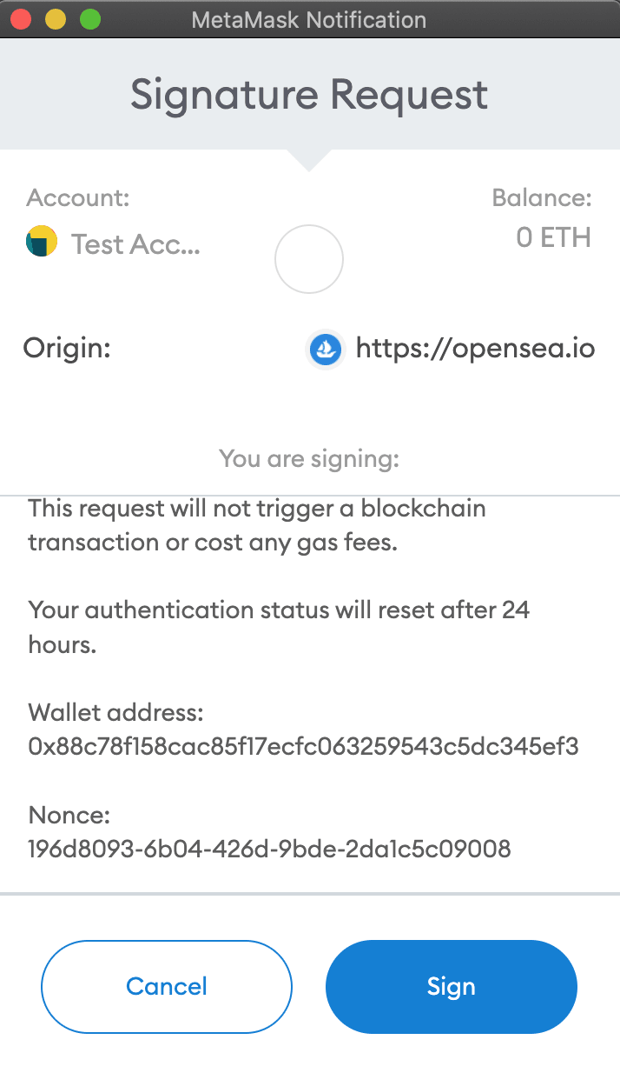
Web3 has an onboarding problem

Slide 9
Mnemonics and keys are not going to get us mass adoption.
Complexity is the killer of adoption.
The ultimate killer dApp for blockchain, is accessibility.
onboarding
discoverability

Slide 10
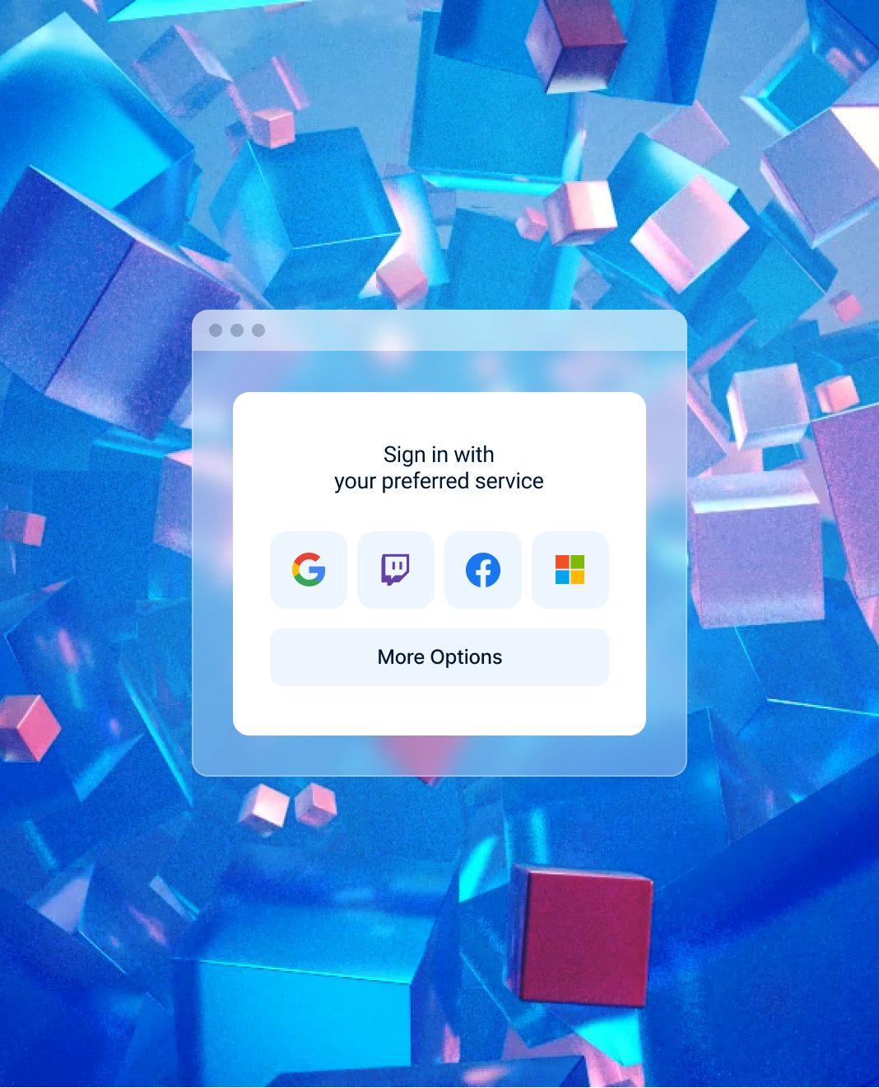
Can we make it as easy as signing in with Google, Facebook and co?
People don’t want to use separate passwords for each and every app, each and every web2 service
Extremely likely they already have a Google, Facebook, Amazon account
Solution: use OAuth to leverage these already existing accounts
https://cdn.vox-cdn.com/thumbor/ncbDuMeGzbUI6Ve0w6npZnclPSQ=/0x0:1125x2184/2000x1333/filters:focal(574x1530:575x1531)/cdn.vox-cdn.com/uploads/chorus_asset/file/22756604/IMG_2175.jpeg

Slide 11


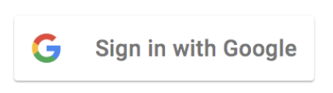

Naive solution: OAuth + Custodial wallet

Slide 12
Can we avoid the trusted custodian?

Slide 13
zkLogin:
OAuth + Zero Knowledge Proof
Non-custodial
User-friendly
Privacy-preserving

Slide 14
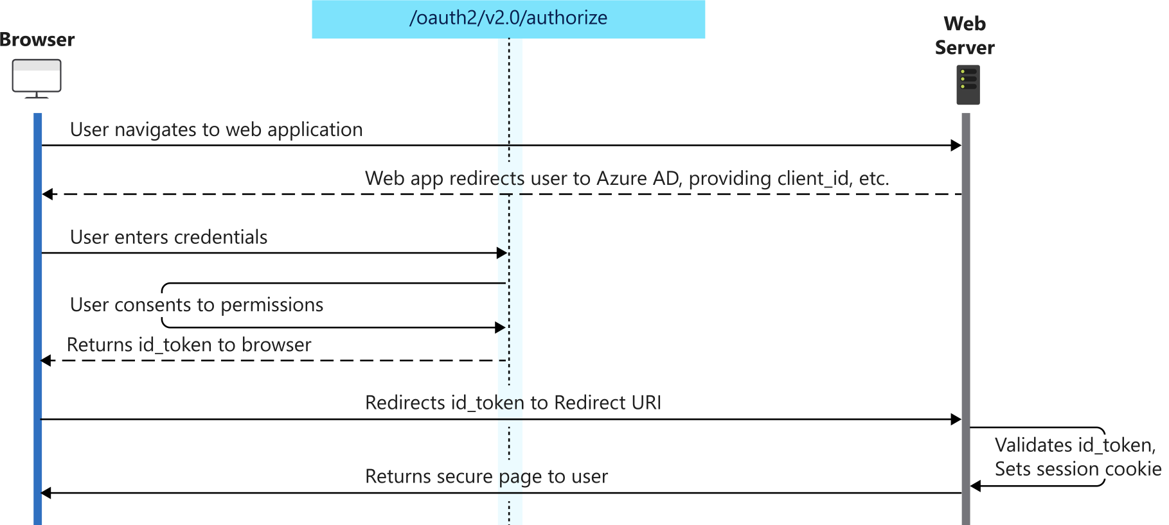

OpenID Connect (an extension of OAuth 2.0)

Slide 15
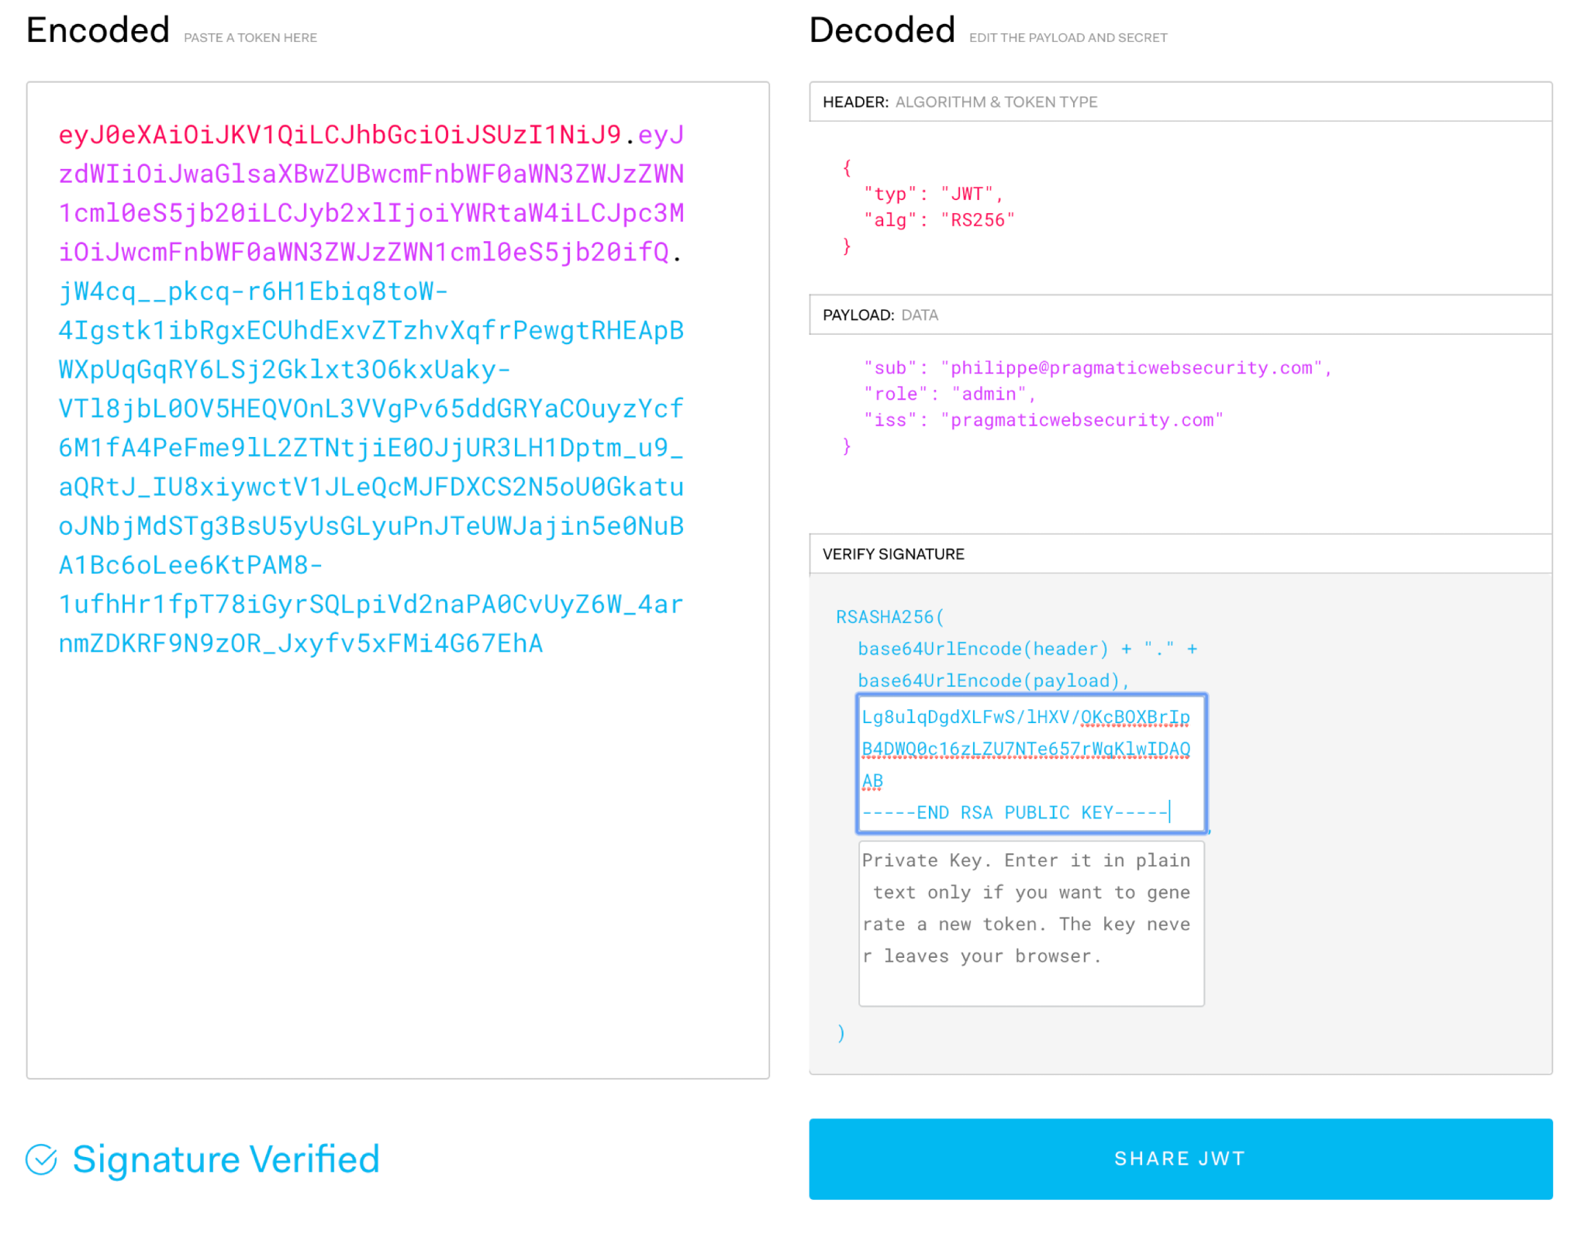
JWT: JSON Web Token
JWT as an alternative to a private key?
Base64-encoded, RSA-signed

Slide 16
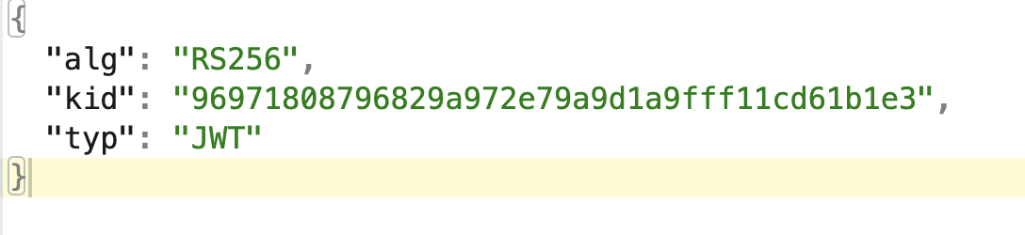
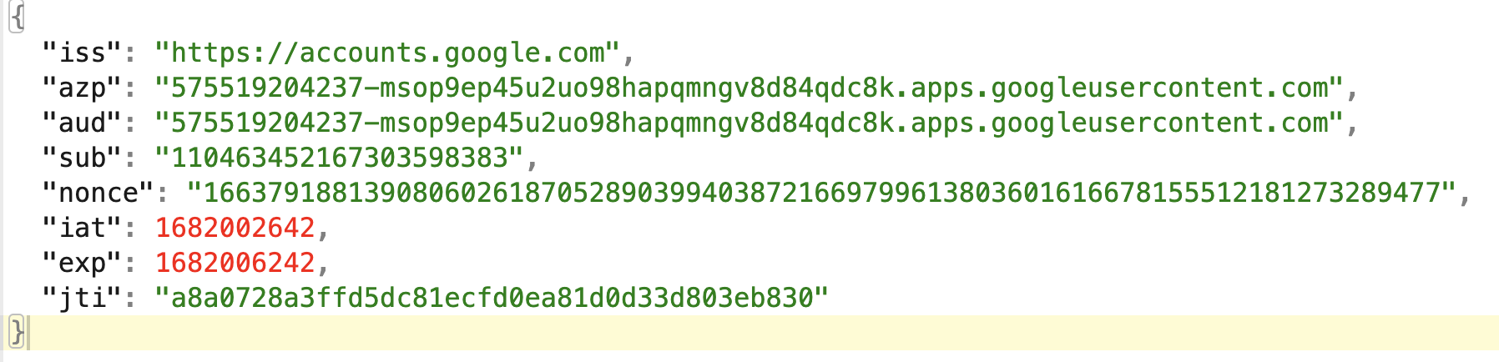
A Google-issued JWT (decoded)
you can ask for email and other personal info

Slide 17
Challenge 1: How to authorize a tx with a JWT?

Slide 18
Inject a fresh pub key into JWT!
replace nonce with user provided data: ephemeral pub key + expiration
We have a DIGITAL CERT over our fresh key + expiration

Slide 19
Challenge 2: How to identify the user without linking identities?
aud = walletID sub = userID we could ask for email too
ADDRESS ???

Slide 20
Add a persistent randomizer: salt
aud = walletID sub = userID we could ask for email too
Salt: A persistent per-user secret for unlinkability
ADDRESS hash(providerID + walletID + userID + salt)

Slide 21

Who maintains the salt?
Client-side on-device management
Edge cases, e.g., cross-device sync, device loss need handling
Server-side management by a “salt service”
Each wallet can maintain their own service / delegate it
Privacy models: Store salt either in TEE or MPC or in plaintext
Auth policies to the service: Either JWT or 2FA
Salt: A persistent per-user secret for unlinkability
ADDRESS hash(providerID + walletID + userID + salt)
Notes:
Salt has other purposes too: ensures zkLogin is non-custodial (OP can’t control account), unlinkability between different accounts of a user

Slide 22
Challenge 3: How to hide the JWT? SNARKs to the rescue!
aud = walletID sub = userID we could ask for email too
nonce = eph. pubKey + expiration
Goal: Prove you have a valid JWT + you know the salt + you injected the ephemeral key into JWT
Verify JWT’s signature using Google’s public key
Verify the ephemeral public key is injected into the JWT’s nonce
Verify that the address is derived correctly from the JWT’s userID, walletID, providerID + user’s salt
Yellow => private inputs Blue => public inputs

Slide 23

zkLogin tricks
sample openID JWT token signed by Google / FB
aud = walletID sub = userID we could ask for email too
nonce = eph. pubKey + expiration
+
ADDRESS ~hash(providerID + zkhash(walletID + userID + zkhash(salt)))
ZK proof
+
=
&
add salt
verify ZKproof
+
verify eph key sig
inject eph key

Slide 24
Challenge 4: Prove + RTT in <3s
We chose Groth16 due to its small proofs + rich ecosystem + fast prover
But.. proofs are slow to generate on end-user devices
Make ZKP efficient: Hand-optimized circuit that selectively parses relevant parts of the JWT + string slicing tricks + …
Delegate proving to an untrusted ZKP service
Open problem: How to delegate with privacy?

Slide 25
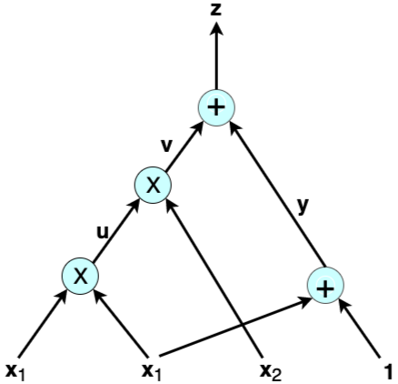
Circuit details
Implemented in circom: ~1M R1CS constraints
Key operations
SHA-2 (66%)
RSA signature verification (14%) using tricks from [KPS18]
JSON parsing, Poseidon hashing, Base64, extra rules (20%)
Prover based on rapidsnark
C++ and Assembly based

Slide 26
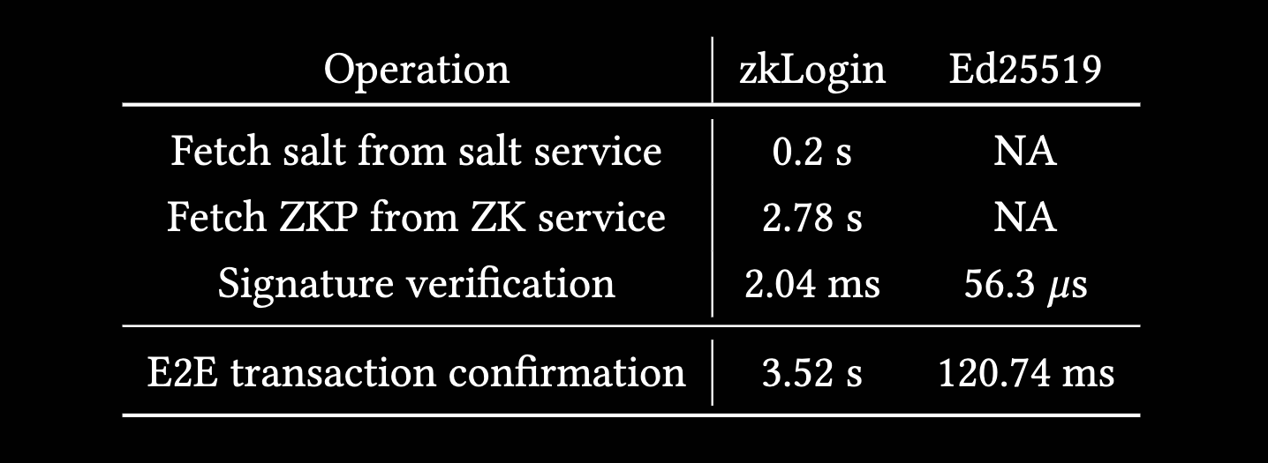
zkLogin latency
These numbers correspond only to the first transaction of a session
Latency for most zkLogin transactions is very similar to traditional ones!

Slide 28








zkLogin
single-click accounts w/
Google Facebook Twitch
Apple
Slack
Microsoft
native authenticator
non-custodial *discoverable, claimable
invisible wallets semi-portable, 2FA

Slide 29
zkLogin goodies
Native auth, cheap
Not via smart contracts, same gas cost as regular sig verification.
ID-based wallets
Create email or phone number based accounts. Can also reveal identity of an existing account (e.g., email) fully or partially (e.g., reveal a suffix like @xyz.edu)
Embedded wallet
Mobile apps or websites can natively integrate zkLogin without the need for a wallet popup!
2FA
Can do a 2-out-of-3 between Google, Facebook and Apple. Salt can also serve as a second factor.
Hard to lose!
Thanks to robust recovery paths of Google, Facebook.
+
ZK proof
ADDRESS hash(providerID + zkhash(walletID + userID + zkhash(salt)))

Slide 30
ZK for authentication
How to SNARK sign-in with Google, Apple & FB
Q & A
Contact deepak@mystenlabs.com
zkLogin technical paper: https://arxiv.org/abs/2401.11735 Sui zkLogin docs: https://sui.io/zklogin

Slide 31
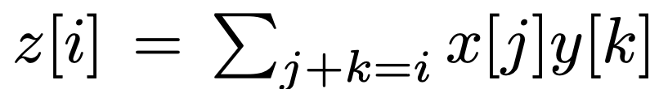
RSA Signature Verification details
Key component in the RSA circuit is BigInteger modular multiplication
Problem statement: Given big nums a, b, modulus p, quotient q and remainder r, verify that a * b = p * q + r
Internally represent a BigInteger as an array of m numbers.
Naive multiplication (without carries) takes O(m^2) constraints. Optimized one only takes O(m) via polynomial interpolation.
Finally, we need to check if the two BigIntegers are same, i.e., do the carries.
Source: [KPS18] Kosba, Ahmed, Charalampos Papamanthou, and Elaine Shi. "xJsnark: A framework for efficient verifiable computation."

Slide 32
Selective JWT parsing
We’d like to parse as little of the JSON Web Token as possible
Assuming that the OpenID Provider sends valid JSONs, we just need to parse the relevant key-value pairs, e.g., sub, nonce, etc.
Key building block: Need to be able to efficiently prove that a substring is part of a bigger string.
Naive slicing: m*n
With bit-width manipulation, we get to 18m + (n*m)/32, which saves as much as 100k constraints per slice.

